Slide 1
OkCupid Profiles:
Team 6: Kevin Cheung, Kathy Han, Changyeol Lee, Peggy Lee, Yuqing Wang
Topic Modeling & Clustering, Sentiment Analysis, and Matching w/ Jaccard Similarity Coefficient
Notes:
Good morning, we are team 6 and we will be presenting our project on okcupid profiles.

Slide 2
Introduction

Slide 3

Introduction
Online Dating Industry:
$912 million revenue in 2019
30.4 million users in the US in 2019
Number of dating app users have been surging during pandemic
Objective:
Improve upon OkCupid’s algorithm by including topic modeling with text analysis and sentiment analysis on free text responses
Specific words used and cluster groups
Notes:
PEGGY
We chose this topic because: there is a significant increase in the industry especially in this current pandemic.
Our objective is to improve upon the apps algorithm and Find specific words used by profiles in the clusters
https://www.pewresearch.org/fact-tank/2020/02/06/10-facts-about-americans-and-online-dating/
https://www.statista.com/topics/2158/online-dating/

Slide 4

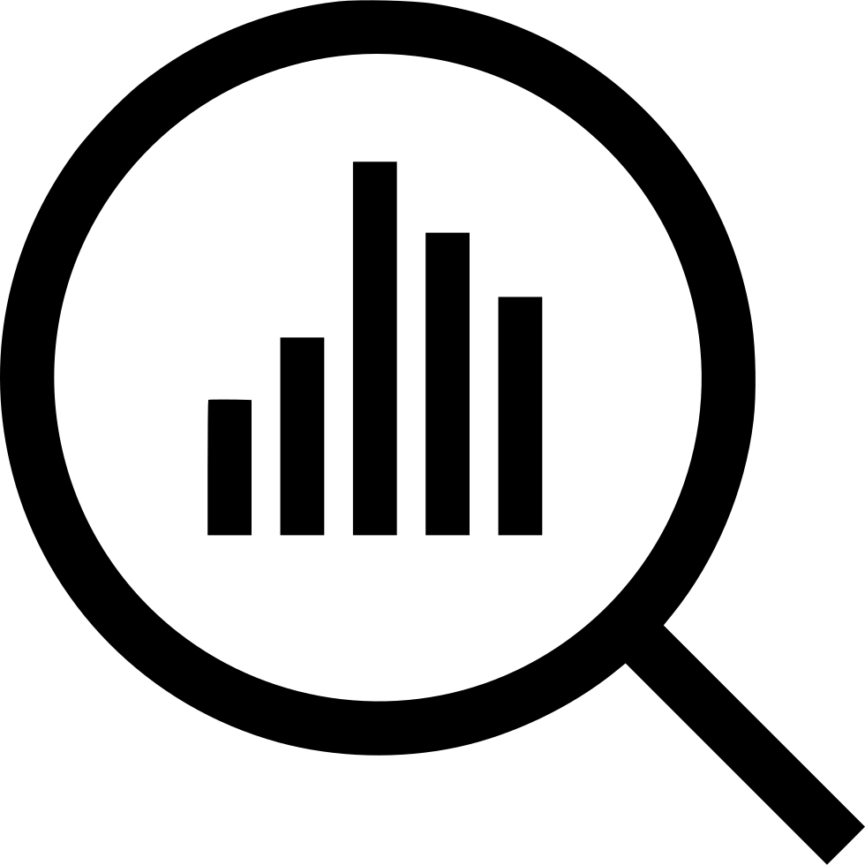






Process Overview
Data Cleaning
Sentiment Analysis
Exploratory analysis
Topic Modeling & Clustering
Matching Algorithm
WordCloud
Conclusion
Q&A
Notes:
PEGGY
We will go over our data cleaning process, analysis, approaches, wordcloud, conclusion and closing with a Q&A

Slide 5
Data Cleaning

Slide 6
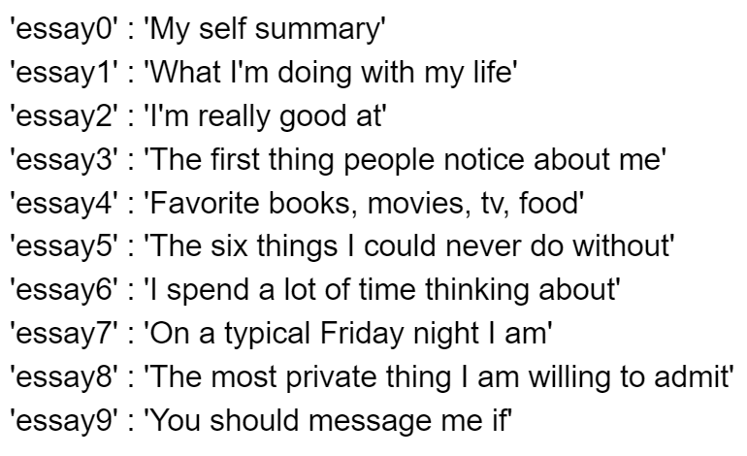
Summary of Dataset
59,946 profiles with 31 variables,
located in the San Francisco region
31 variables included and 10 topic specific essays and basic bios such as:
Age
Profession
Education
Sexual Orientation, etc.
Notes:
The dataset also includes the following profile attributes: age, relationship status, gender, sexual orientation, body type, diet, drinking, drug usage, education, ethnicity, height, income, job, last time online, location, offspring, pets, religion, astrological sign, smoking, and language spoken.
There almost 60 thousand profiles with 31 variables. For the 31 variables it included 10 essay topic.
On the right side are the essay topics.

Slide 7
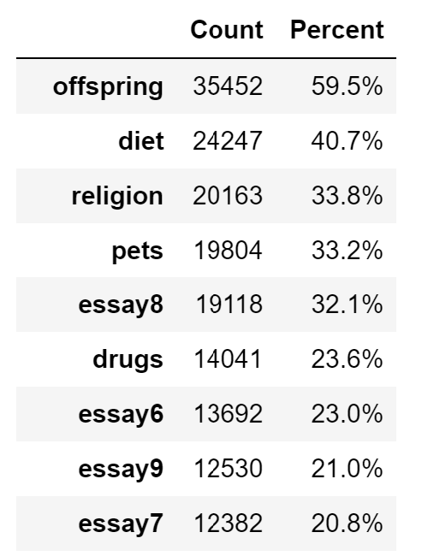
Dataset Pre-processing
NA values
Too many NA values (55,700 rows contain NA values)
Removing values might cause different outcomes (purposeful blanks)
Ages
65 is the average retirement age -> Not ideal subject of experiment -> Remove users over 64
Notes:
For example, on the image to the right, this table shows the count and percentage of NAs in the dataset that exceed 20%. Most interestingly, essay 8 'The most private thing I am willing to admit' and 'essay6' : 'I spend a lot of time thinking about' are extremely personal” and were left out by a large portion of users.
These blank spaces are interesting and were purposefully left blank by the user. Removing these values can alter matching outcomes. Instead, we replaced NA values with 0 instead of removing them.
Instead, we removed users over 64 as the average retirement is 65. This also removed extreme outliers such as users who labeled themselves as over 100 years old.
If we were to remove based on IQR, we would have needed to remove about 3k profiles over 52 years old, which removed a demographic (baby boomers) we were interested in.
Within our dataset there are Too many NA values (55,700 rows contain NA values), if we Removing values might cause different outcomes

Slide 8
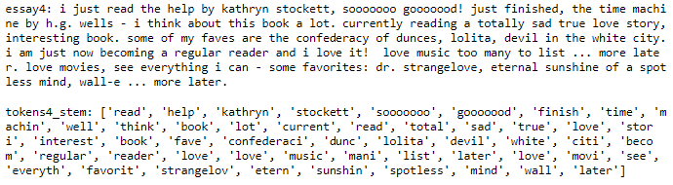
Dataset Pre-processing
Textual analysis (Essays)
Remove punctuation, white spaces, convert uppercase to lowercase
Remove stopword using nltk stopwords (179 words)
Tokenization and Stemming
Notes:
For our textual analysis we have 2 tokenization functions: one with stemming and one without stemming.
Both of these functions included remove punctuation, white space, converting uppercase to lowercase and removing 179 stopwords by using nltk.Then we tokenized each sentence, then we tokenized each word.
The image below is the before and after result tokenization with stemming and removing stop words.

Slide 9
Exploratory Analysis
Notes:
Next we have our exploratory analysis
Here are some demographic visualizations, comparing different descriptive characteristics across gender.

Slide 10
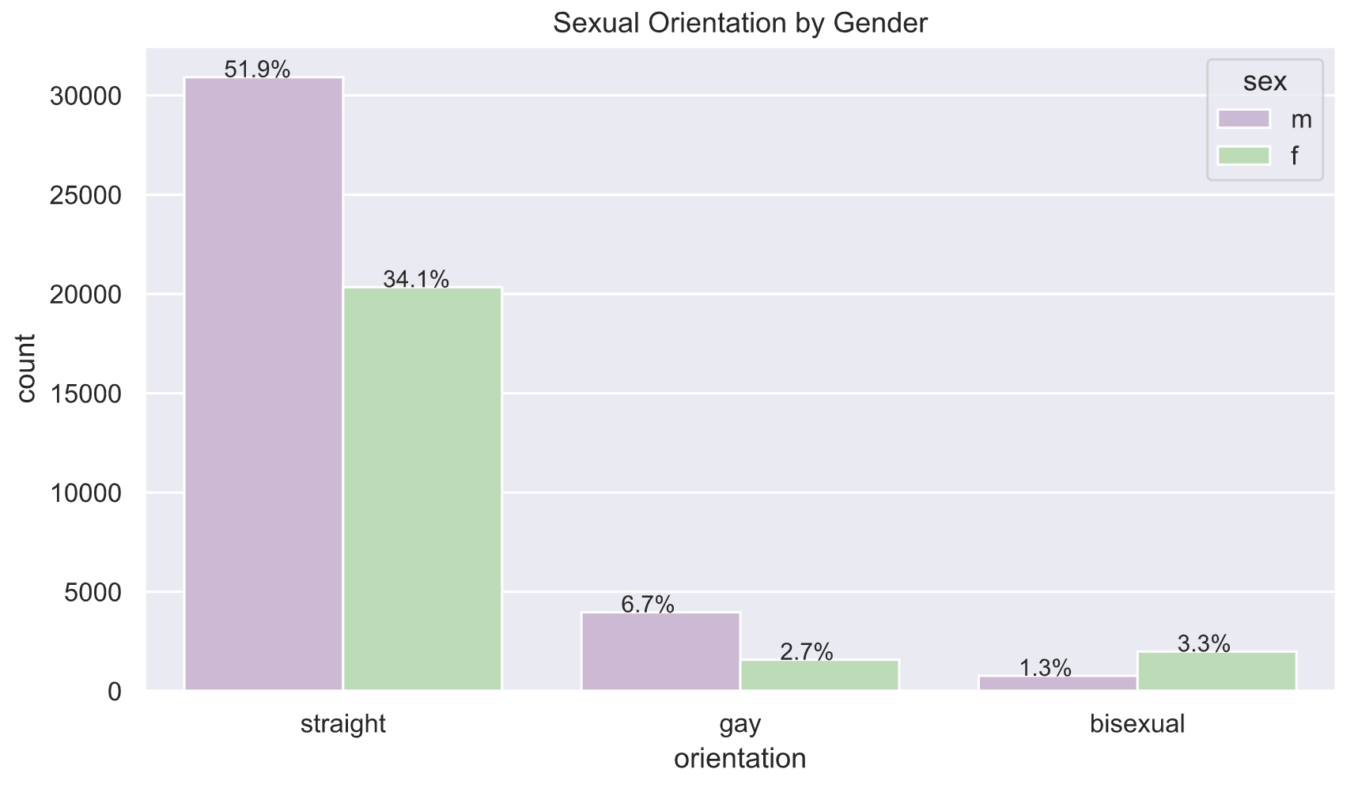
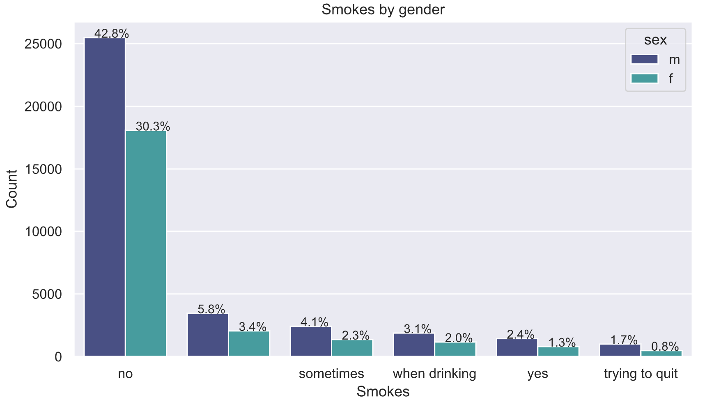
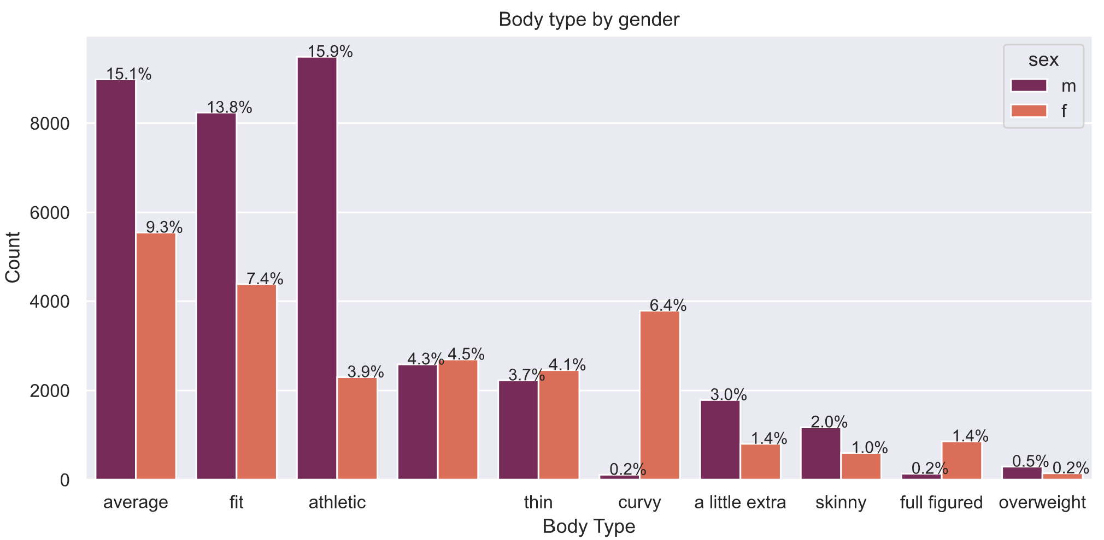
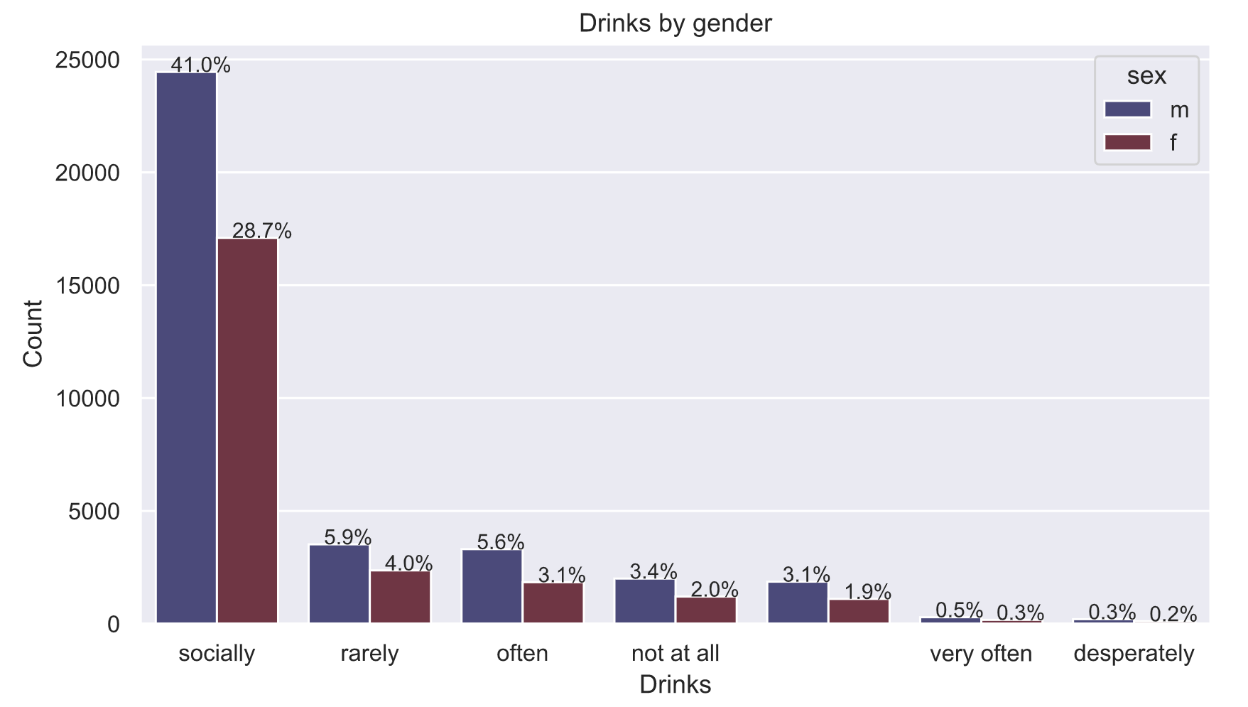
Demographic Visualizations
Notes:
Here are some demographic visualizations, comparing different descriptive characteristics across gender.
For the most part, males and females filled out the questionnaires in a similar manner.
A majority of users do not smoke and they drink socially.
Also, under the body type attribute, men tended describe themselves as average and fit.
However, women left this attribute blank or labeled themself as thin, curvy or full figured.

Slide 11
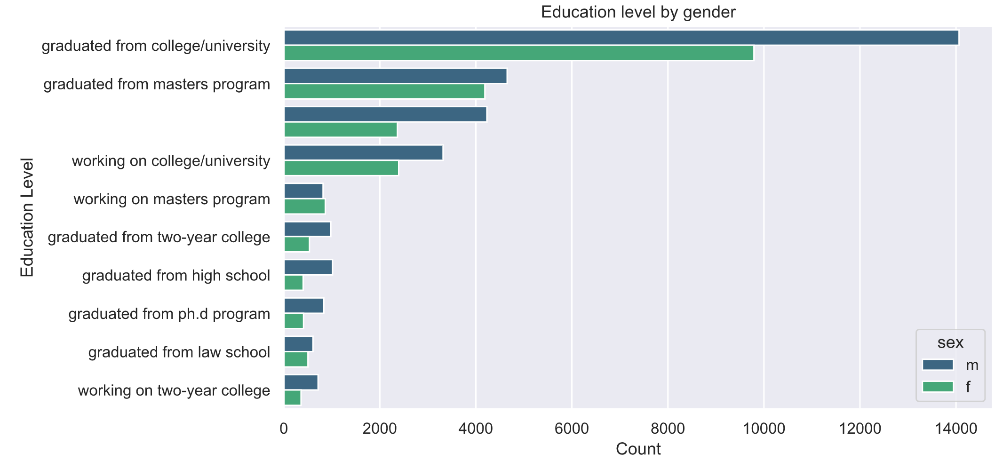
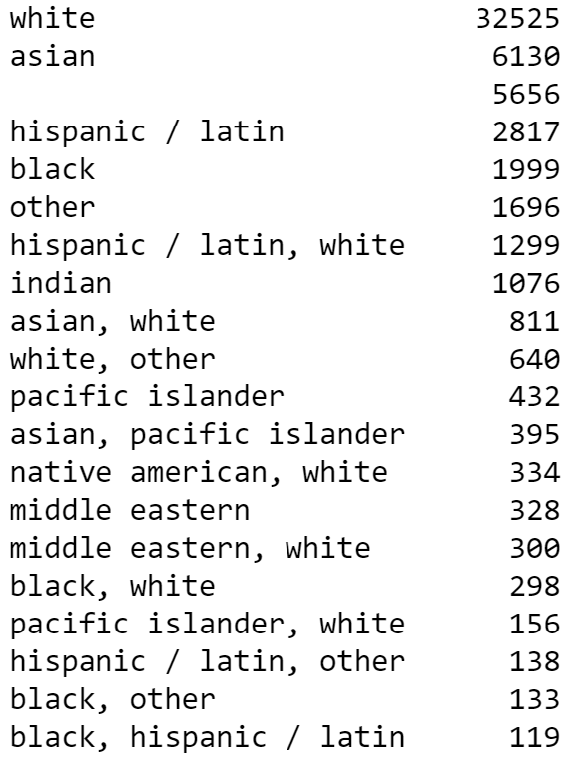
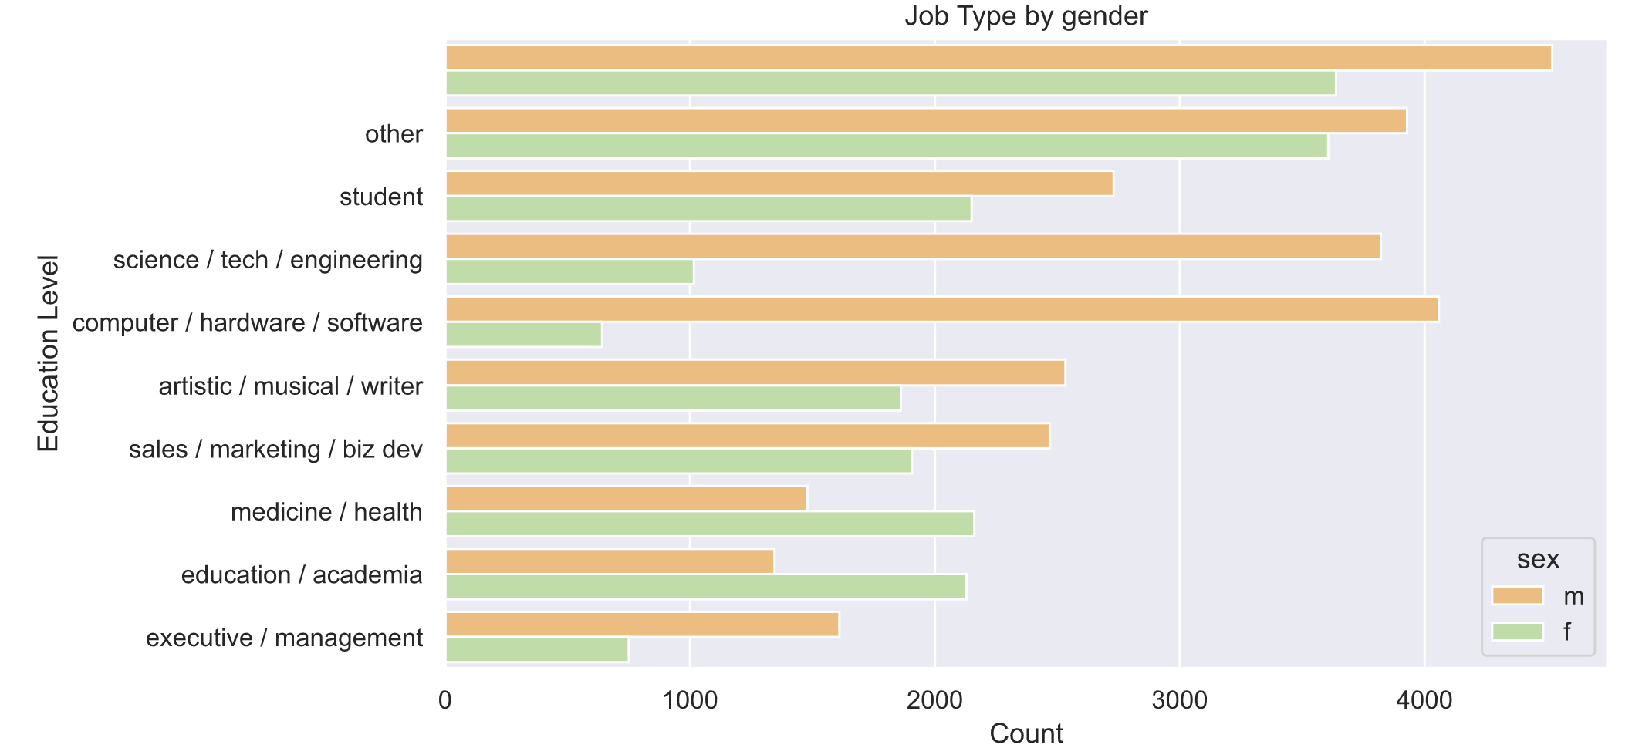
Demographic Visualizations
Notes:
On the left are the Visualizations on education level and job type by gender.
When looking at the education attribute, women and men were more even in the masters program category.
Also, since these profiles were located and collect based in SF area, it is not surprising to see that a lot of user’s jobs were in the STEM industry. While a a large portion of females are in the healthcare/education industry.
On the right side are our ethnicity breakdown.

Slide 12
Topic Modeling & Clustering

Slide 13
Topic modeling & Approaches
Topic modeling
LDA (Latent Dirichlet Allocation) - probabilistic graphing model
NMF (Non-negative Matrix Factorization) - linear algebra
Approaches to perform LDA and NMF
CountVectorizer : unstemmed and stemmed tokens - assigns count in matrix
TfidfVectorizer : unstemmed and stemmed tokens - assigns score or weight in matrix
Notes:
LDA is based on probabilistic graphing modeling, which will return the documents that belong to a topic in a corpus and the words that belong to a topic. LDA uses the CountVectorizer as a document word matrix input.
NMF is based on linear algebra, which uses the original matrix (A) from the TfidfVectorizer and gives two matrices (W and H). W is the topics found and H is the weights for those topics.
CountVectorizer tokenizes a collection of text documents. This returns an encoded matrix with a length of the entire corpus and a width of word count with a frequency count under each word.
TF-IDF quantifies a word in documents, which computes a weight to each word, signifying the importance of the word in the document and corpus.
TfidfVectorizer will tokenize documents, learn the vocabulary and IDF weightings, and returns a matrix of TF-IDF features.
Both of these models cluster profiles/documents to discover topics based on their contents.

Slide 14
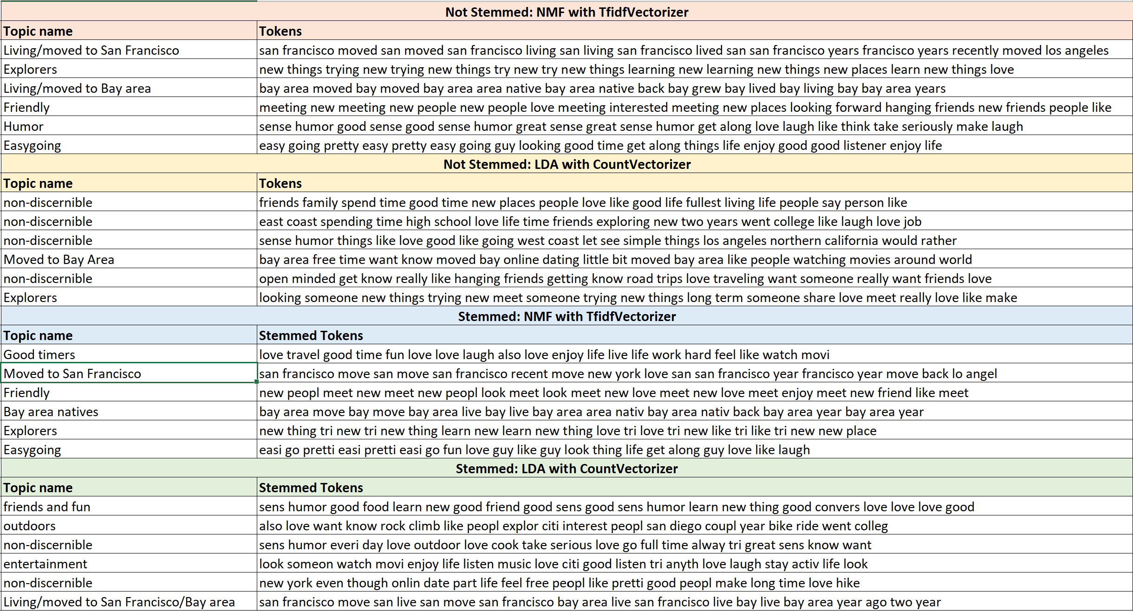
Results - “My Self Summary”
Notes:
LDA has much more non discernible topics than NMF.
We were able to extract topics from NMF with TfidfVectorizer on both nonstemmed and stemmed tokens.
We decided to go with NMF with TfidfVectorizer on stemmed tokens as this includes stemmed tokens and would be better for analysis.

Slide 15
Proceed with NMF with TfidfVectorizer (stemmed)
Condition:
Words appeared in less than 0.5% in whole essay are ignored
Only bigrams and trigrams are extracted
20 topics (clusters) extracted
Notes:
extract bigrams and trigrams (a sequence of two and three adjacent elements from a string of tokens).

Slide 16
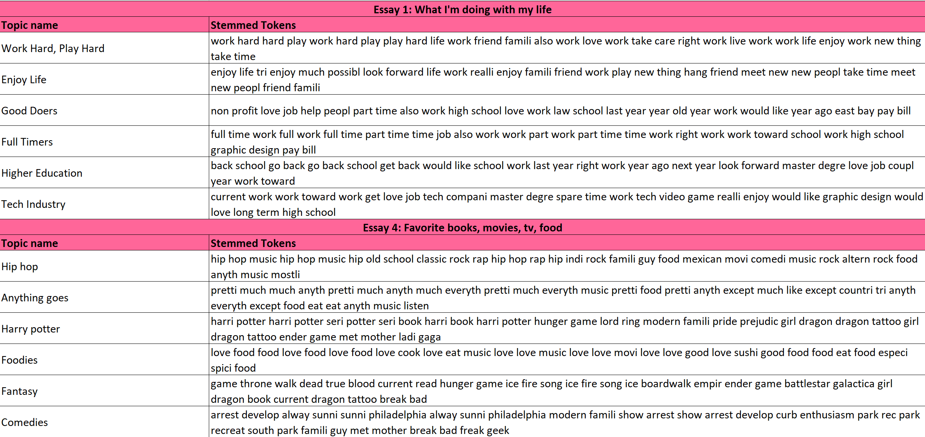
Result - Essay 1 (What I’m doing with my life) and Essay 4 (Favorite books, movies, tv, food)
Notes:
We extracted 6 random clusters from essay 1 and essay 4 as these essays were among the most filled in essays. We were able to discern topics from each cluster.
These clusters can be utilized by OkCupid to cluster profiles based on what they write in their essays. These essays have much more personal information than the generic attributes. The words that appear earlier in the token column appear most often throughout the profiles.
If users were to rank these essays and OkCupid took these rankings into account, they can improve user matching experience.
Essay 1 - life style (Work hard & play hard, Enjoy life, Good doers, Full timers, Higher education, Tech Industry)
Essay 4 - Hiphop, Anything goes, Harry potter, Foodies, Fantasy, Comedies

Slide 17
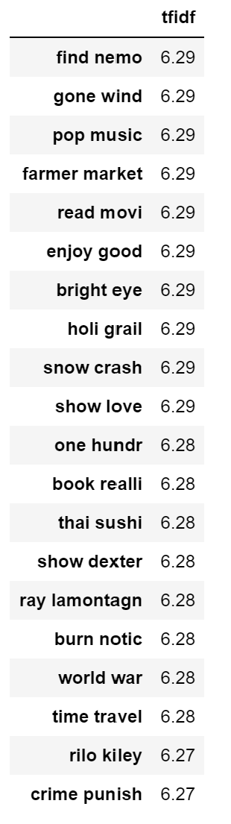
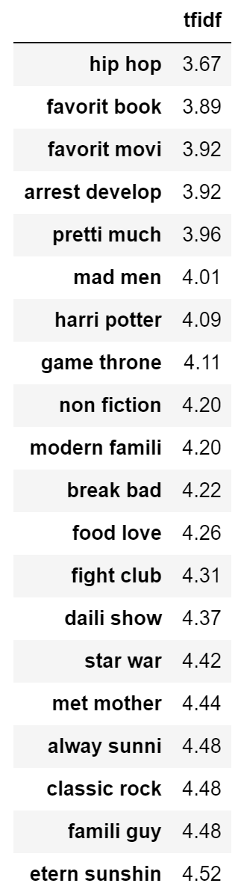
Lowest and Highest TF-IDF scores
Lowest weights:
most common across profiles
→ hip hop, arrested development, mad men, harry potter, game of thrones
Highest weights:
least common across profiles
→ finding nemo, gone with the wind, pop music, farmers market
“Favorite Books, Movies, Tv, Food”
Notes:
Highest and lowest word usage
People can connect based on fandom words - game of thrones and harry potter.
Also connect on current life situation, working full time, non profit, grad school.
If users were more niche specific, then connect on finding nemo or master degree.
Left(essay4)
Right(essay1)

Slide 18
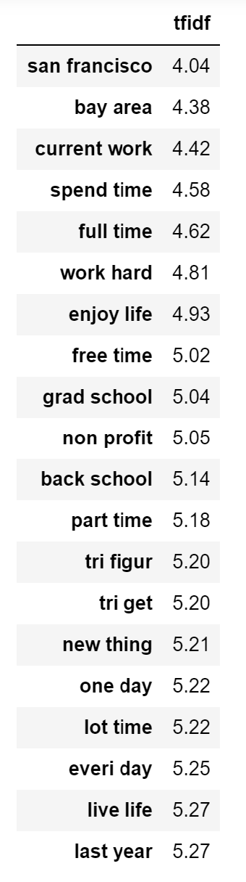
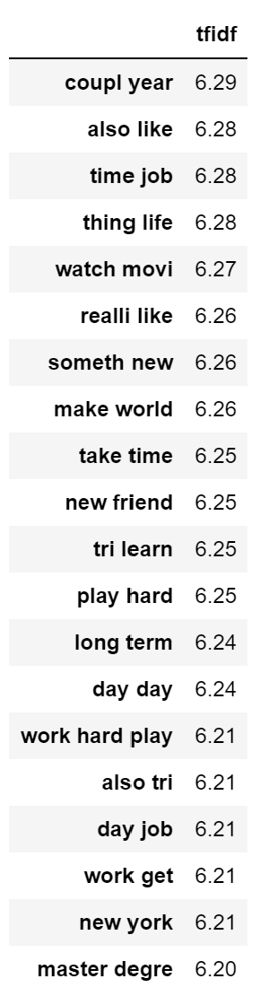
Lowest and Highest TF-IDF scores
Lowest weights
→ san francisco/bay area, currently working, full time, work hard, enjoying life
Highest weights
→ watching movies, something new, make world, try learn
“What I’m doing with my life”
Notes:
Here users can connect on current life situation, working full time, non profit, grad school, among this topic

Slide 19
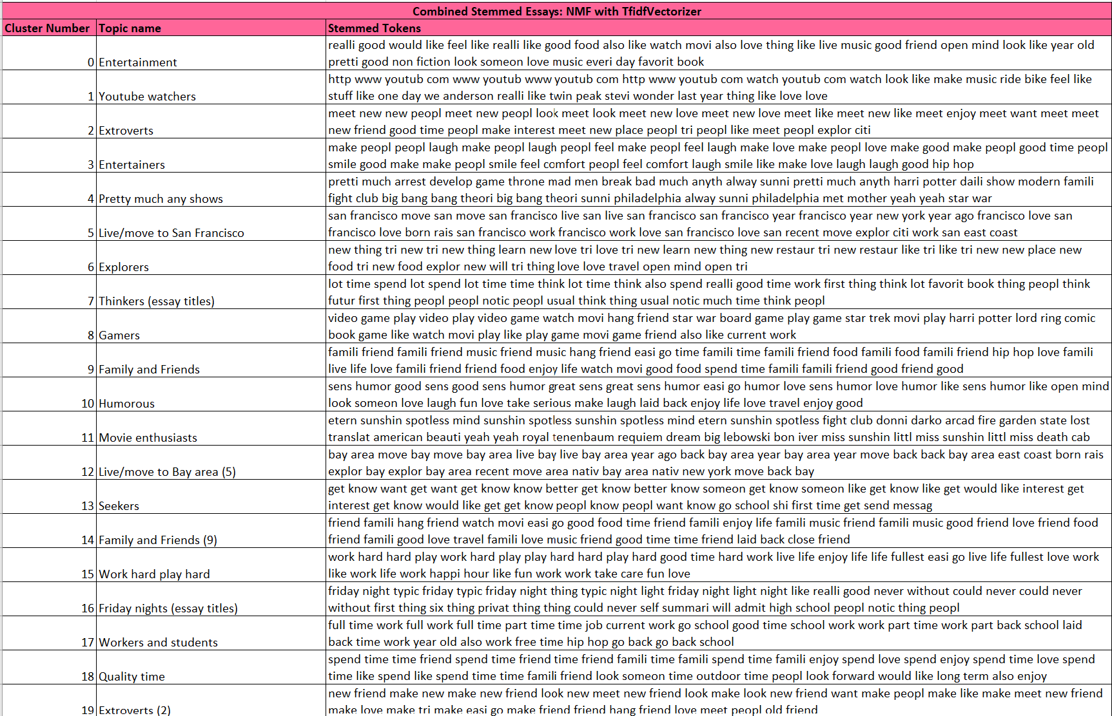
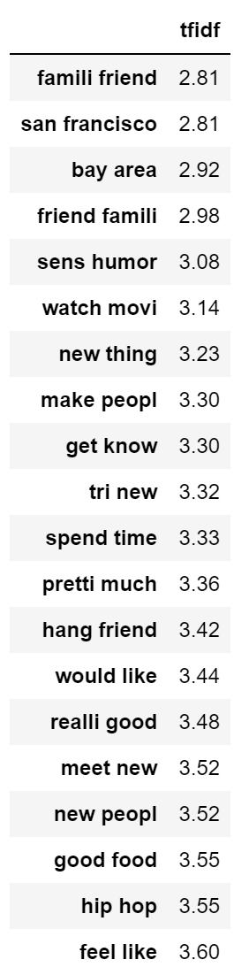
Combined Essay
Top 20 frequent words
Notes:
For our analysis, we combined all 10 essays into one essay chunk and performed topic modeling. We were able to label all 20 clusters. There were a couple clusters that had similar topics such as family and friends or San Francisco/Bay Area.
We will use these clusters in our matching algorithm.
We can see the top 20 words that appeared throughout all the combined essays in the whole corpus or across all essays. People like family and friends, sense of humor, watching movies, trying new things and so on.

Slide 20
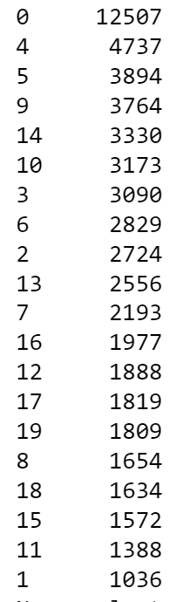
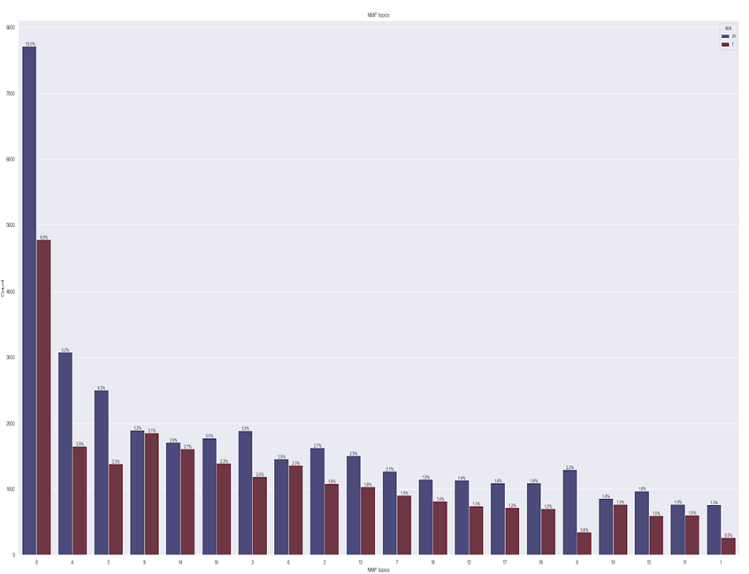
Male vs. Female clusters
Cluster Groups
Males and Females have similar tendencies
Entertainment
Live/Moved to San Francisco
Any Shows
Family & Friends
Live/Moved to San Francisco
Family & Friends
Workers and Students
Humorous
Entertainers
Extroverts
Explorers
Seekers
Work Hard Play hard
Friday Nights
Gamers
Youtube Watchers
Thinkers
Extroverts
Movie Enthusiast
Quality Time
Notes:
Clusters 9 and 14 - family and friends group (male and female more evenly distributed)
Cluster 6 - trying new things/explorers (male and female more evenly distributed)
Cluster 8 - Gamers, big difference between male and female
Cluster 1 (in the last cluster) - Youtubers

Slide 21
Sentiment Analysis

Slide 22
Sentiment Analysis
Measures:
Polarity [-1, 1]
Subjectivity [0, 1]
Negative
Neutral
Positive
-1
0
1
Factual Information
Personal Information
0
1
Notes:
Regading sentiment analysis, we applied Textblob package using the default pattern anlyzer. Textblob measures text based on Polarity and subjectivity.
Polarity measures how positive or negative a user is. Subjectivity measures how subject a profile is. Higher score implies that the user includes more personal texts.
We performed sentiment analysis with TextBlob using the default PatternAnalyzer.
Textblob measures text based on 2 criteria: Polarity and Subjectivity.
Polarity is a measure of how negative or positive a user is.
Subjectivity is a mesaure of how subjective a profile si - so profiles that have a higher score includes more personal or subjective text.
Positive 55322
Neutral 2731
Negative 1521

Slide 23
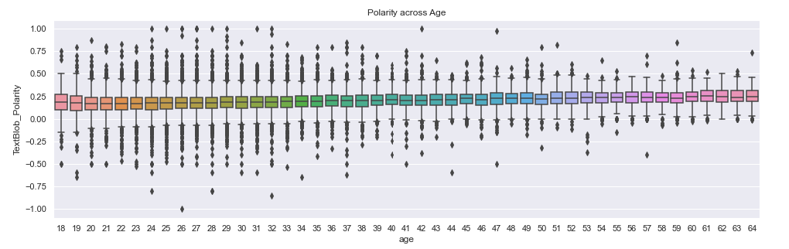
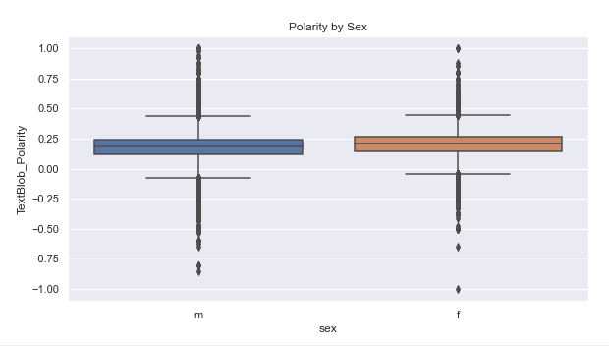
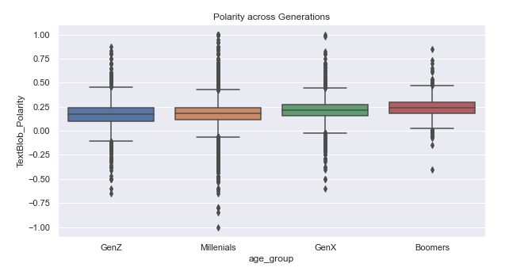
Notes:
So applying this method, We want to find the sentiment analysis across demographic groups. First, among ages, we can see that as the users get older, users tend to be positive.Between the sex, females are more positive than male, while among the generations, x-generation and babyboomers have higher score.
We wanted to explore the sentiment across different demographic groups.
From the plots above, we can see that as age increases, sentiment or positivity increases.
Also, extreme negativity decreases across generations .GenX and Millenials have relativiely the same polarity score, but Baby Boomers has a higher score.
Females have higher polarity (more positive) and higher subjectivity (more personal)

Slide 24
Matching Algorithm with Jaccard Similarity

Slide 25
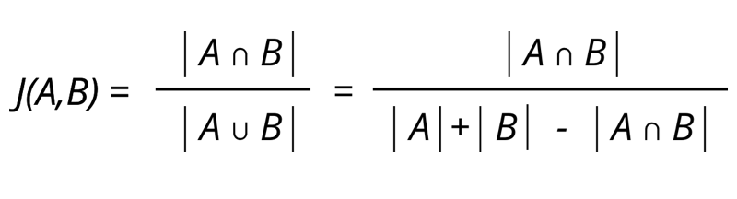
Matching Algorithm with Jaccard Similarity
Matching Algorithm - matches profiles based on conditions we set:
Sexual orientation (gay or straight), gender, cluster, and sentiment
Then finds best match between values based on highest Jaccard Similarity score
Jaccard Similarity - A ratio of measuring the similarity between two sets.
The Jaccard index has a value between 0 and 1.
The higher the value, the more similar the two sets are.
Notes:
We also want to find the ideal partners using Jaccard similarity. Jaccard similarity measures how users are similar. We also set some conditions that users clusters and sentiments must be the same. So our algorithm finds best match based on jaccard similarity score and the condition.
Jaccard Similarity score function - The Jaccard Similarity is the ratio of the size of the intersection of two sets to the size of their union. Score is between 0 and 1 and the 1 is the highest.
Applying jaccard similarity, our matching function calculates all the scores between the user and all other profiles. And the function selects the profile with the highest score.
We set the condition where cluster and sentiment has to match .

Slide 26
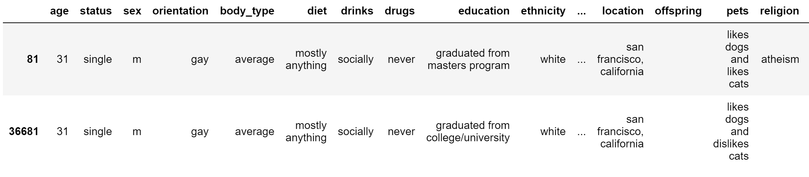
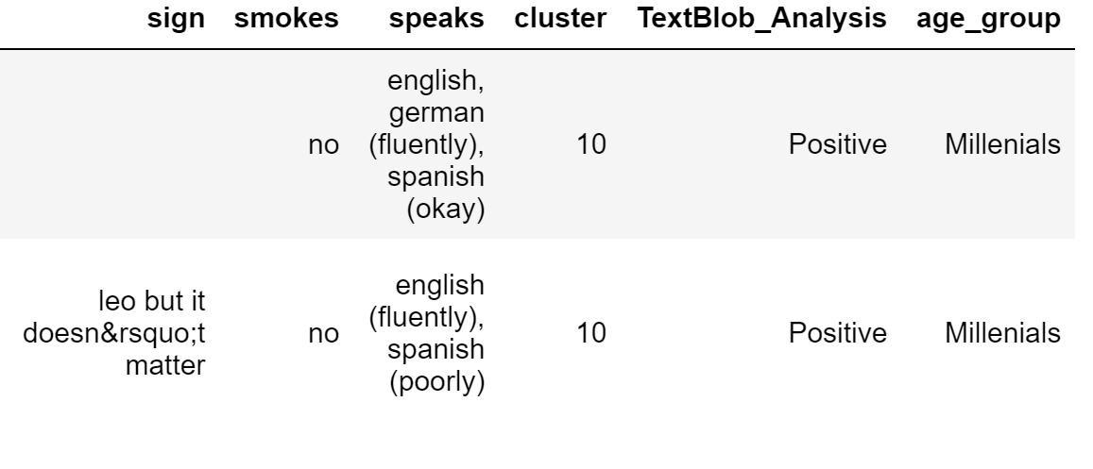
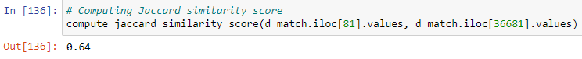
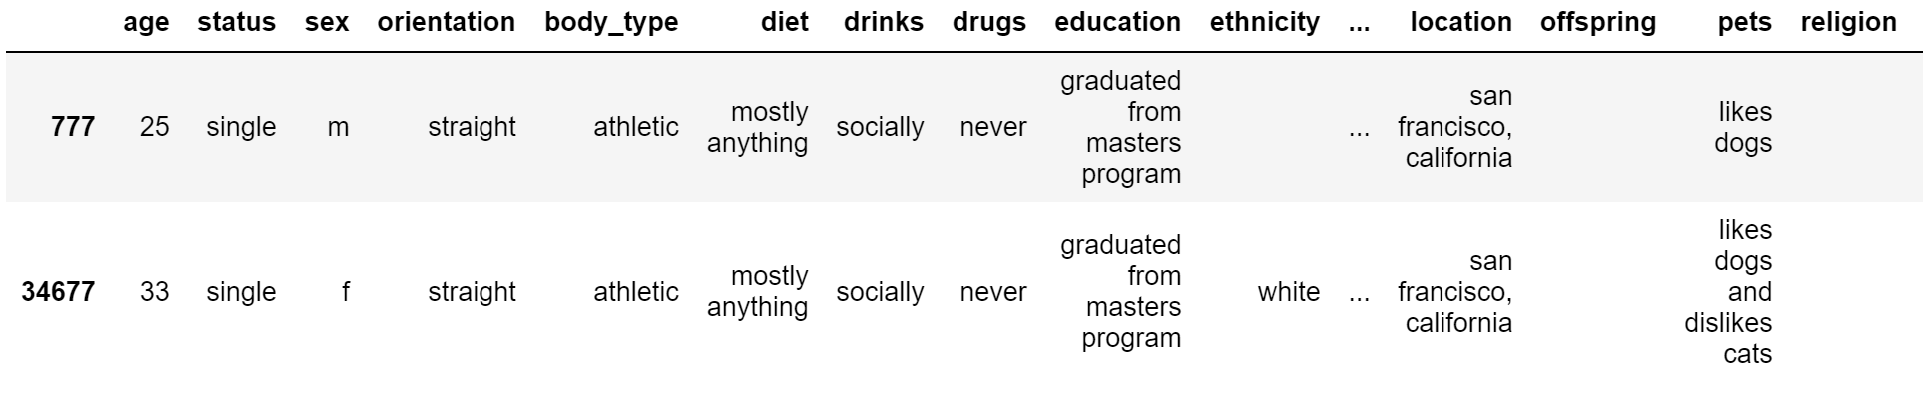
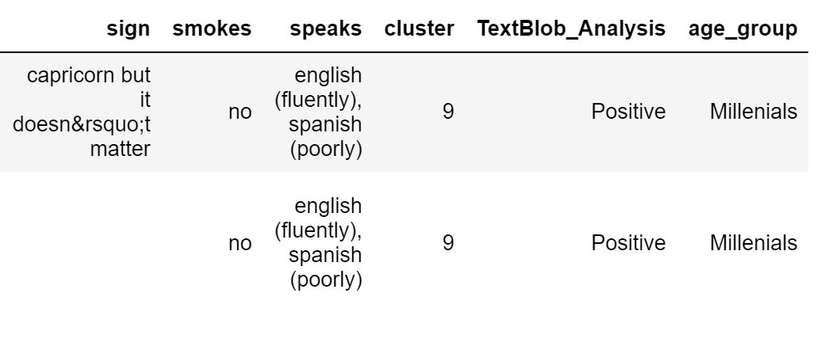
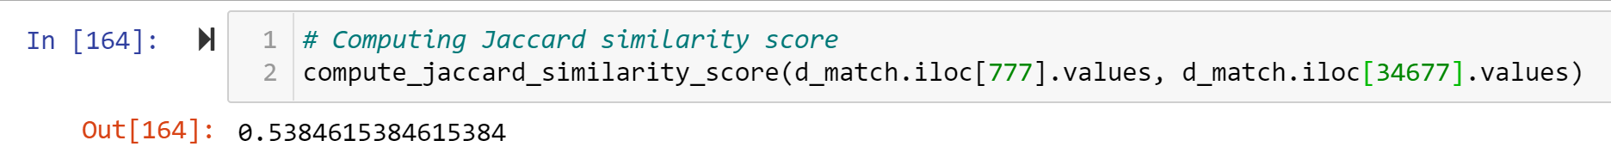
Results
Notes:
In the first match, the algorith matched a gay male with another gay male at a 64% Jaccard similarity score.
We also test the algorithm on straight male and female, which gave a similarity score of 53.8%.
This is an unsophisticated and simple model compared to OkCupid’s algorithm, however it shows how we can incorporate topic modeling and clustering, text analysis, and sentiment analysis, in improving the matching algorithm.

Slide 27
WORDCLOUDS

Slide 28
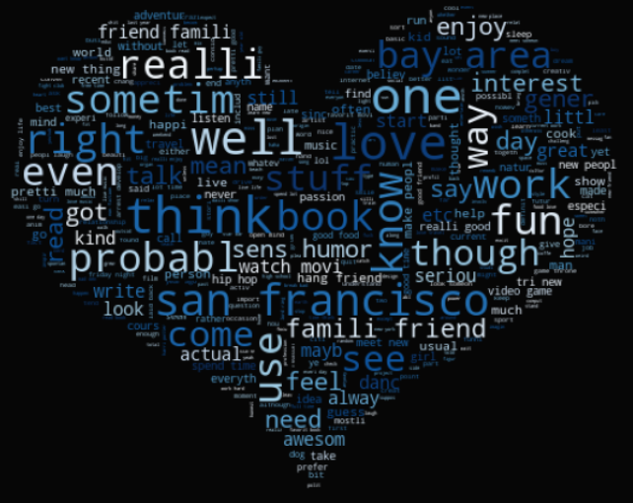
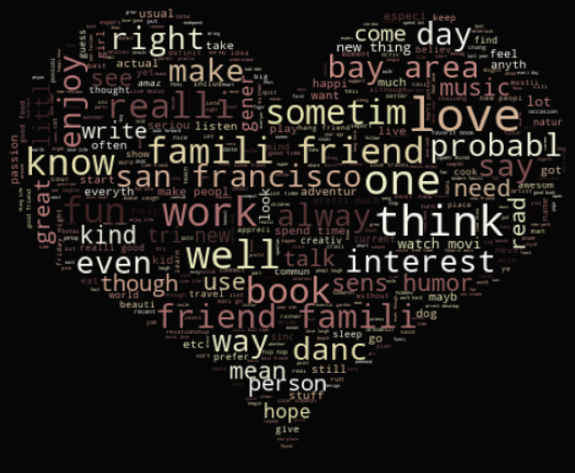
WORDCLOUD
MALE
FEMALE
Notes:
PEGGY
Here we word clouds comparing the top words among male and female profiles where Females tend to mention family/friends more than males do.

Slide 29
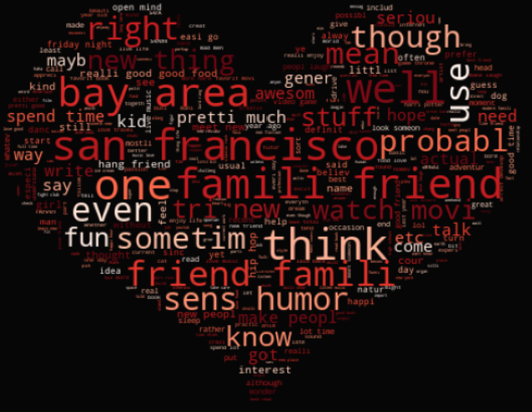
Combined WORDCLOUD
Notes:
PEGGY
While in the combined word cloud, top mentions are SF/ bay area, family/ friend, sense humor

Slide 30

Conclusion
The words that users use in their essays can play a significant part in the success of finding a significant other.
OkCupid can use the power of text analysis to improve user experience.
Monetize this: users pay for a premium feature to be matched with users based on their essays. Users can rank their essays and OkCupid can cluster profile using topic modeling.
Notes:
This is an unsophisticated and simple model compared to OkCupid’s algorithm, however it shows how we can incorporate topic modeling and clustering, text analysis, and sentiment analysis, in improving the matching algorithm.
Some things to improve: dataset did not include any match rate or meet up rate. This can help in creating a success rate or be used in predictive modeling.

Slide 31
Thank you

Slide 32
Q & A

